Slide 1
Servlet and Java server pages
MVC Architecture- Servlets - TOMCAT Directory Structure for a Web Application - Servlet API Overview - Servlet Life Cycle - GenericServlet & HttpServlet - ServletConfig & ServletContext - JSP Directives, Simple JSP Page - JSP Tags - JSP & Java Beans - Session Management using JSP

Slide 2
Java server pages – JSP
JavaServer Pages (JSP) is a complimentary technology to Java Servlet which facilitates the mixing of dynamic and static web contents.
JSP is Java inside HTML

Slide 3
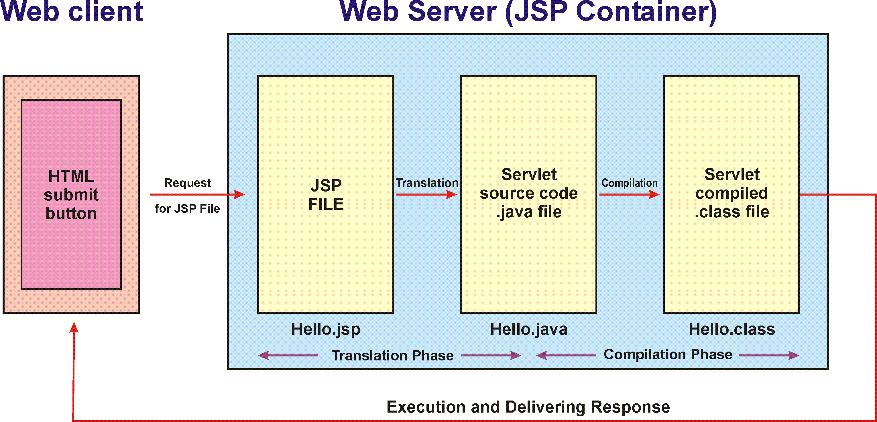
JSP Architecture

Slide 4
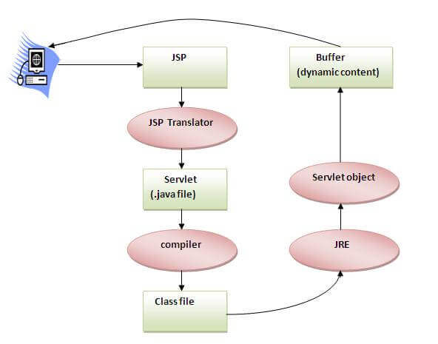
JSP Life Cycle
Translation of JSP Page
Compilation of JSP Page
Classloading (the classloader loads class file)
Instantiation (Object of the Generated Servlet is created).
Initialization ( the container invokes jspInit() method).
Request processing ( the container invokes _jspService() method).
Destroy ( the container invokes jspDestroy() method).

Slide 5
JSP API
The JSP API consists of two packages:
javax.servlet.jsp
javax.servlet.jsp.tagext
javax.servlet.jsp package
Interfaces
JspPage
HttpJspPage
Classes
JspWriter
PageContext
JspFactory
JspEngineInfo
JspException
JspError

Slide 6
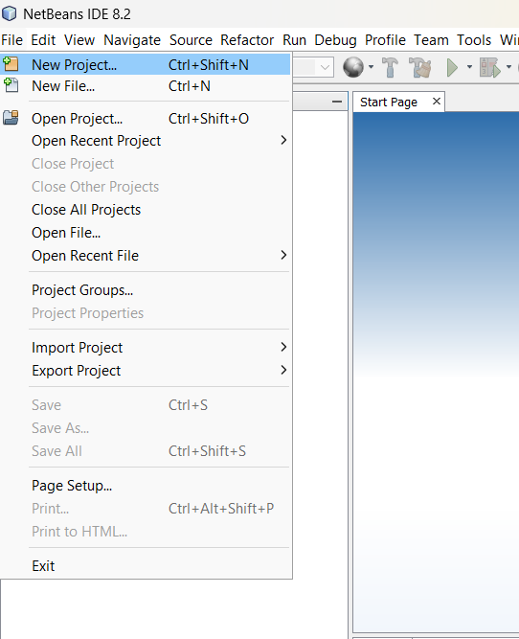
Simple JSP Project Creation
Open Netbeans, click File -> New Project

Slide 7
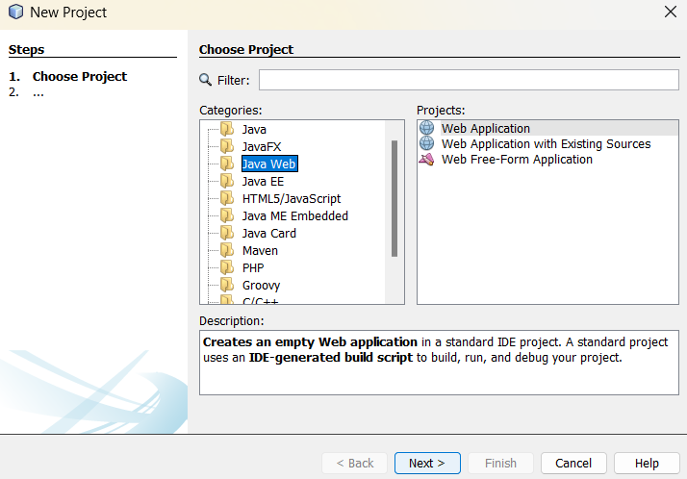
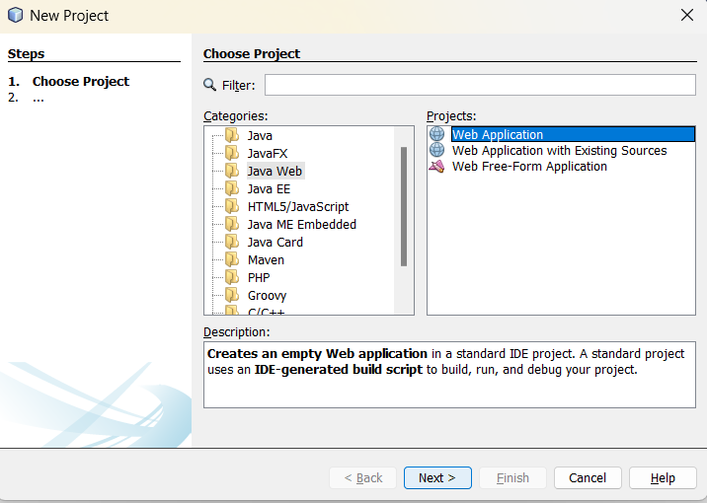
Simple JSP Project Creation
Select Java Web or Java with Ant->Java Web
Then choose Web Application on right panel

Slide 8
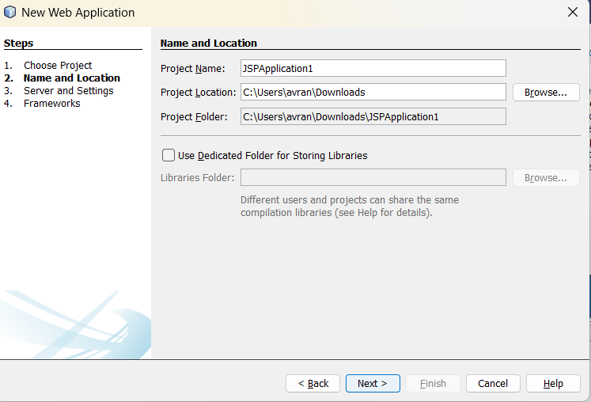
Simple JSP Project Creation
Give name to the project. Here, “JSPApplication1”.
Then, Click “Next”

Slide 9
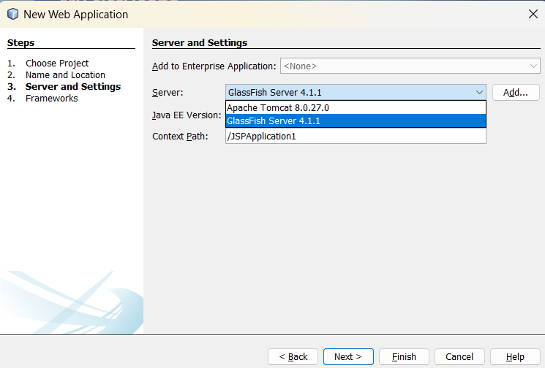
Simple JSP Project Creation
Now choose the server “Apache Tomcat” or “GlassFish Server”
Click “Next”

Slide 10
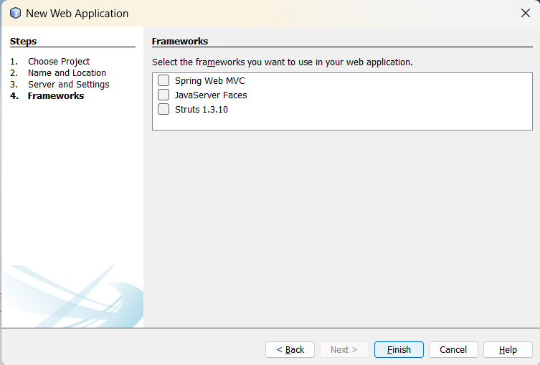
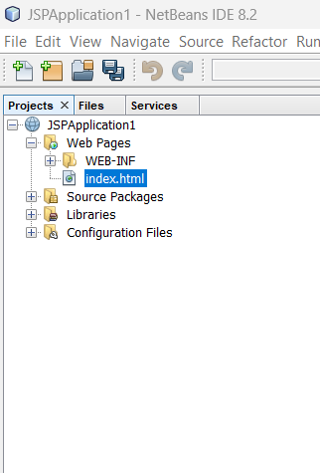
Simple JSP Project Creation
The Project Structure now:
If any framework is required, then choose any one from the available list. Or simply
Click “Finish”

Slide 11
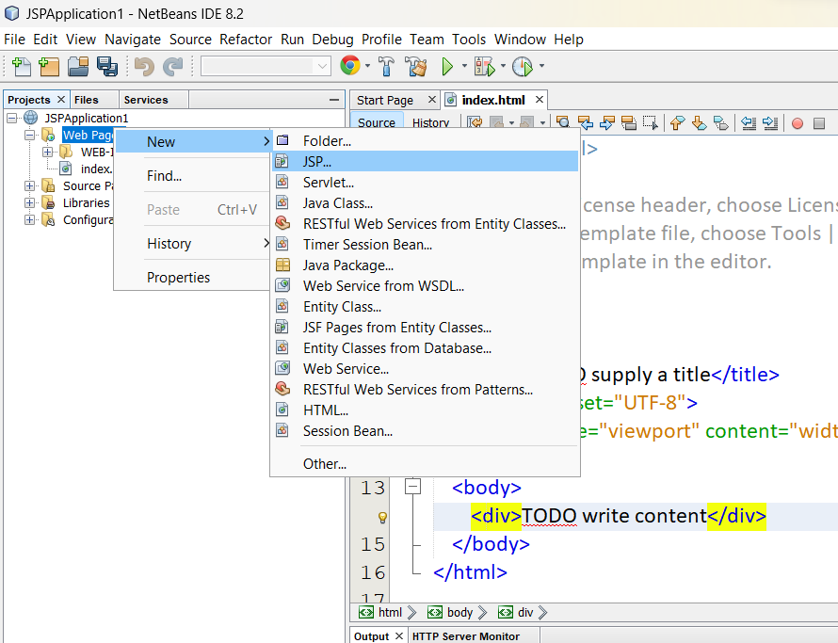
Simple JSP Project Creation
Now create JSP page as follows:
Right click over “Web Pages” -> New -> “JSP”

Slide 12
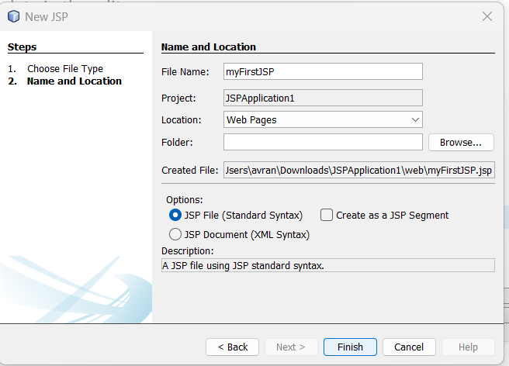
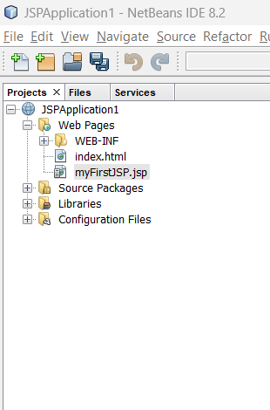
Simple JSP Project Creation
The Project Structure now:
Name your JSP page. Here, “myFirstJSP”
Then click Finish

Slide 13
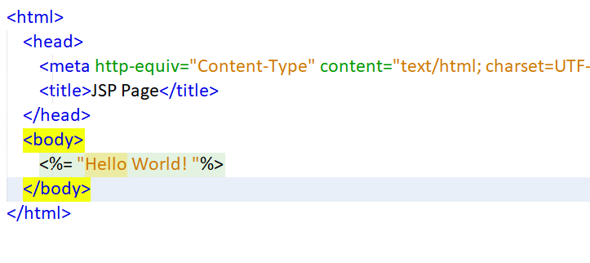
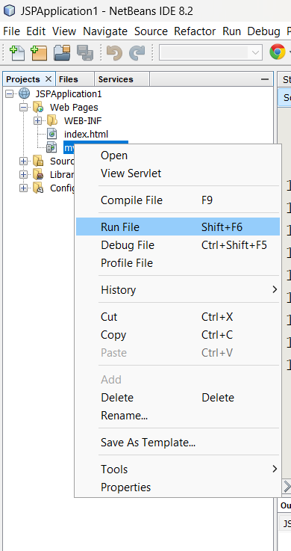
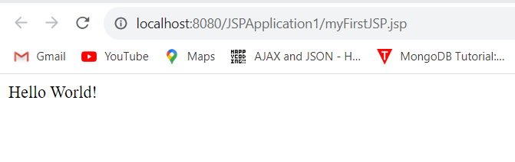
Simple JSP Project Creation
Edit the myFirstJSP as shown in the picture
Run the file as shown below:
The Output Browser

Slide 14
JSP Basics
JSP Tags
Reading Form Data
Implicit Objects
JSP Directives

Slide 15
Jsp Tags
Comments => <%-- ….. --%>
Scriptlet => <% ….. %>
Expression => <%= …..%>
Declaration => <%! ….%>

Slide 16
JSP Comments
JSP comments <%-- JSP comments --%> are ignored by the JSP engine
E.g.
<%-- anything but a closing tag here will be ignored -->

Slide 17
JSP SCRIPTLET
JSP scripting element are enclosed within <% ...... %>. The Java codes in the JSP script are translated according to their respective types:
JSP Scriptlet <% .... %>: used to include Java statements, or part of Java statement. JSP scriptlets allow you to implement more complex programming logic.
E.g.
<%
String author = request.getParameter("author");
if (author != null && !author.equals(""))) {
%>
<p>The Chosen author is <%= author %></p>
<%
}
%>

Slide 18
JSP Expression
JSP Expression <%= .... > used to evaluate a single Java expression to obtain a value
E.g.
<%= Math.sqrt(5) %>
<%= item[10] %>
<p>The current date and time is: <%= new java.util.Date() %></p>

Slide 19
JSP Declaration
JSP Declaration <%! Java Statements %> - used to declare variables for methods and class.
Example
<%! String name, regnum;
int id, mark1,mark2;
int []arr = new int[10];
%>

Slide 20
JSP Implicit Objects
There are 9 JSP implicit objects. These objects are created by the web container that are available to all the jsp pages.
Object | Type
out | JspWriter
request | HttpServletRequest
response | HttpServletResponse
config | ServletConfig
application | ServletContext
session | HttpSession
pageContext | PageContext
page | Object
exception | Throwable

Slide 21
JSP – Reading Form Data
JSP handles form data parsing automatically using the following methods depending on the situation:
getParameter(): call request.getParameter() method to get the value of a form parameter.
getParameterValues(): Call this method if the parameter appears more than once and returns multiple values, for example checkbox.
getParameterNames(): Call this method if you want a complete list of all parameters in the current request.
getInputStream(): Call this method to read binary data stream coming from the client.

Slide 22
Develop JSP Code
<html>
<body>
<form method="post" action="JSPPage1.jsp">
Name: <input type="text" name="username"><br>
Age: <input type="number" name= “userage">
<input type="submit" value="CLICK HERE">
</form>
</body>
</html>
<%@page contentType="text/html" pageEncoding="UTF-8"%>
<!DOCTYPE html>
<html>
<title>JSP Page</title>
</head>
<body>
<%! String name;
int age; %>
<% name=request.getParameter("username");
age = Integer.parseInt(request.getParameter("userage"));
%>
<%-- DISPLAY OUTPUT --%>
Name: <%= name%><br>
Age: <%= age%><br>
</body> </html>

Slide 23
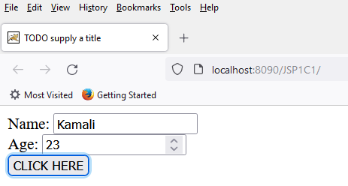
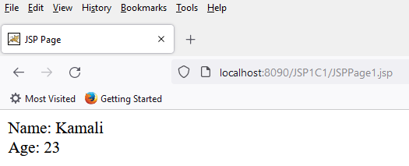
Deploy Project
http://localhost:8090/JSP1C1/Index.html
http://localhost:8090/JSP1C1/JSPPage1.jsp

Slide 24
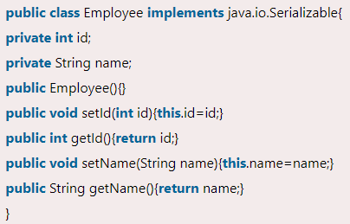
Java Bean Class
Java Bean class is a reusable software component. A bean encapsulates many objects into one object so that we can access this object from multiple places. Moreover, it provides easy maintenance. A JavaBean is a Java class that should follow the following conventions:
It should have a no-arg constructor.
It should be Serializable.
It should provide methods to set and get the values of the properties, known as getter and setter methods.
Simple Bean Class

Slide 25
Java Bean Class
To access the JavaBean class, use getter and setter methods. A JavaBean property is a named feature that can be accessed by the user of the object. The feature can be of any Java data type, containing the classes that you define.
JavaBean features are accessed through two methods in the JavaBean's implementation class:
1. getPropertyName ()
For example, if the property name is firstName, the method name would be getFirstName() to read that property. This method is called the accessor.
2. setPropertyName (parameter)
For example, if the property name is firstName, the method name would be setFirstName() to write that property. This method is called the mutator.

Slide 26
Bean – Advantages and Disadvantages
Advantages of JavaBean
The JavaBean properties and methods can be exposed to another application.
It provides an easiness to reuse the software components.
Disadvantages of JavaBean
JavaBeans are mutable. So, it can't take advantages of immutable objects.
Creating the setter and getter method for each property separately may lead to the boilerplate code.

Slide 27
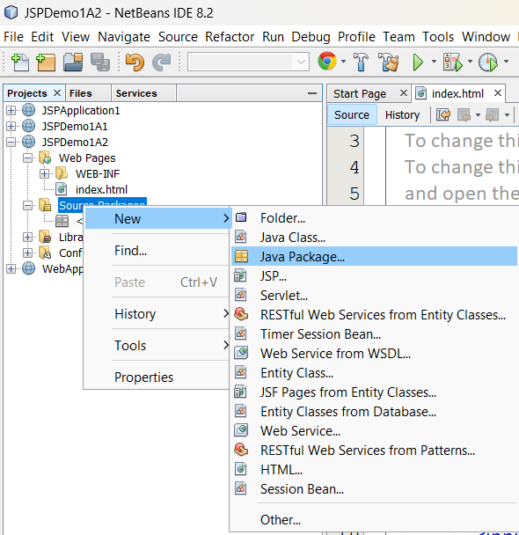
Bean Class Creation
Right click on “Source Packages → new → Java Package “

Slide 28
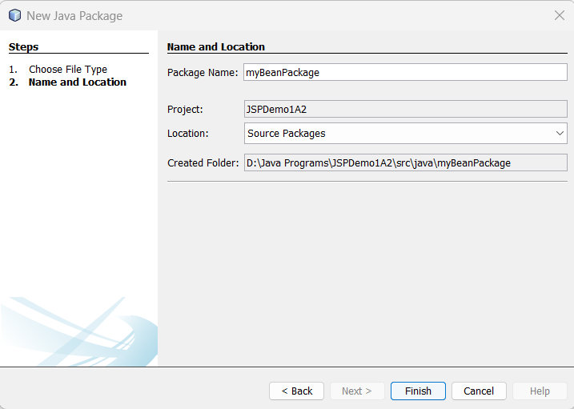
Bean Class Creation
Now, provide the package name “myBeanPackage” (or your choice)
Click “Finish”

Slide 29
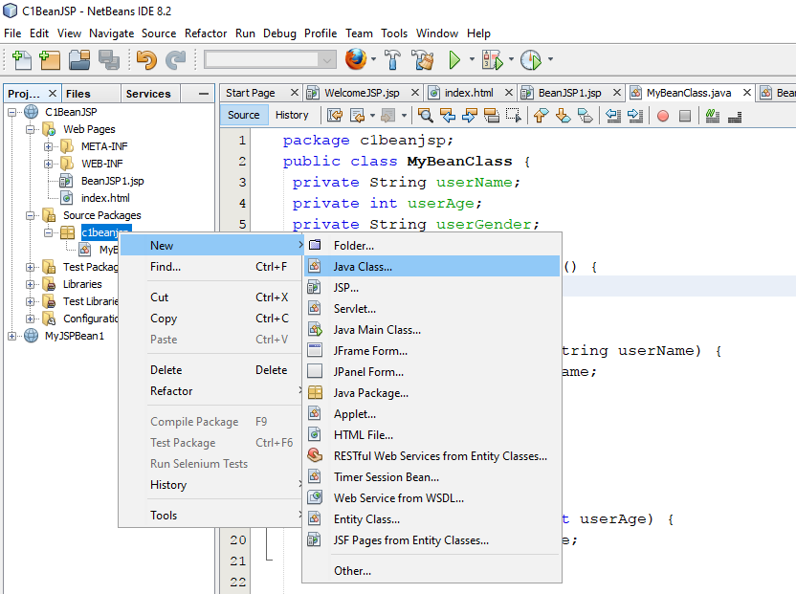
Bean Class Creation
Right click on “myBeanPackage” then click “new” → “Java Class”

Slide 30
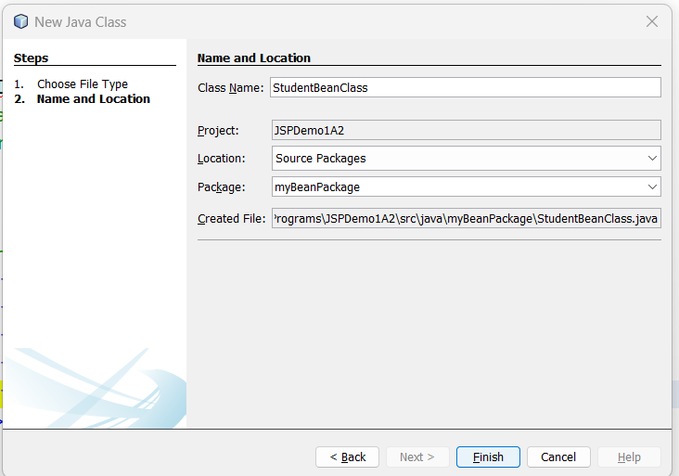
Bean Class Creation
Provide a name to that Java class. Here, “StudentBeanClass”. Click “Finish”

Slide 31
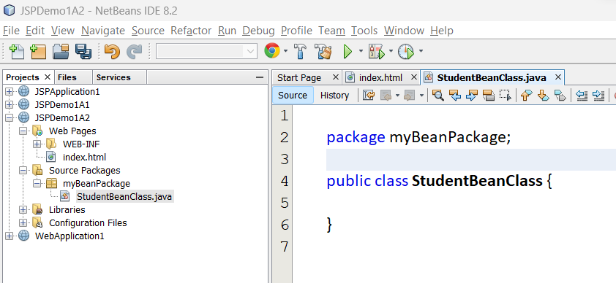
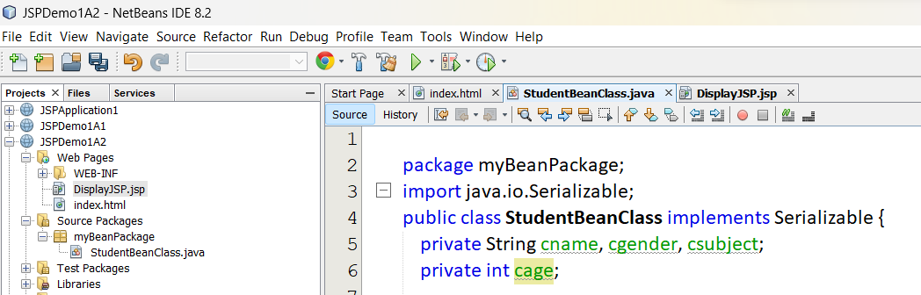
Bean Class Creation
Initial Window
Define the required members

Slide 32
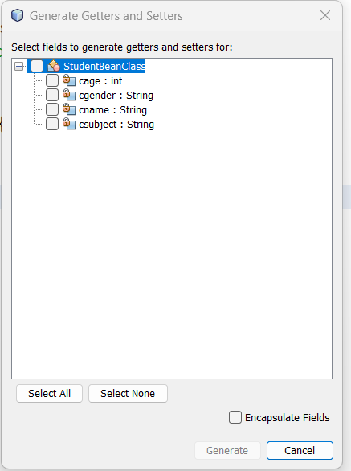
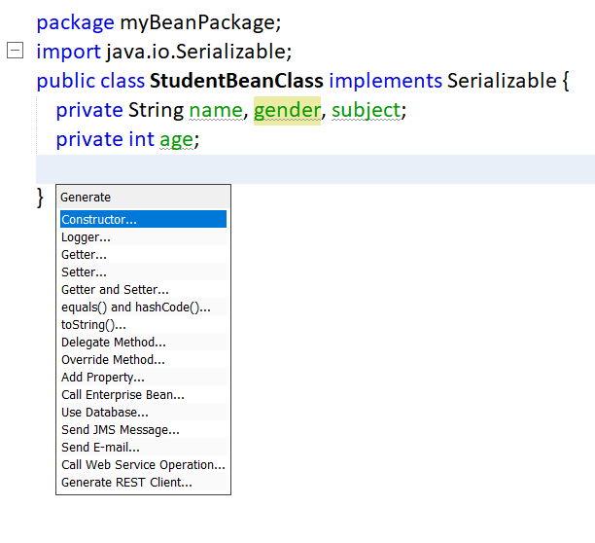
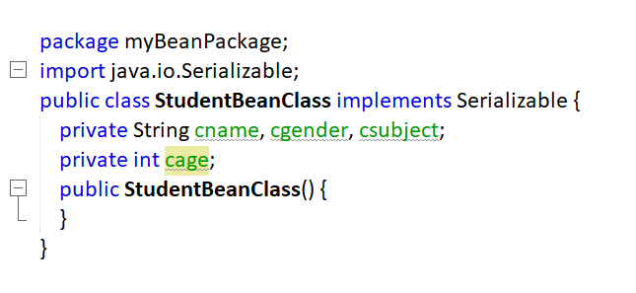
Bean Class Creation
Constructor Creation

Slide 33
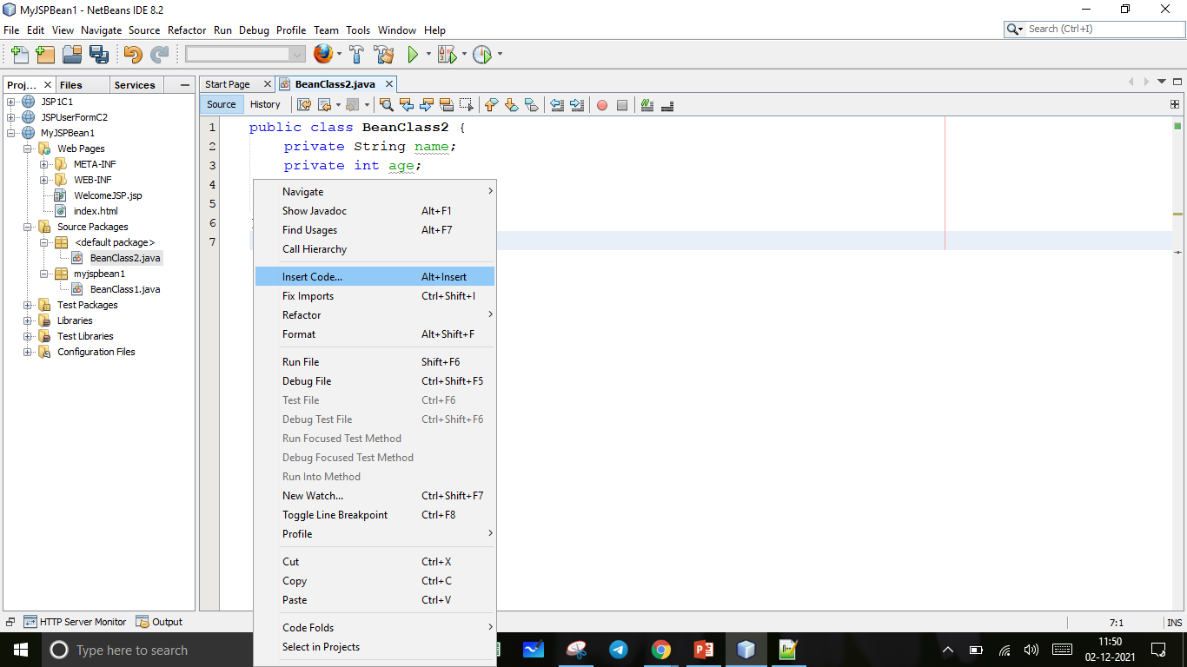
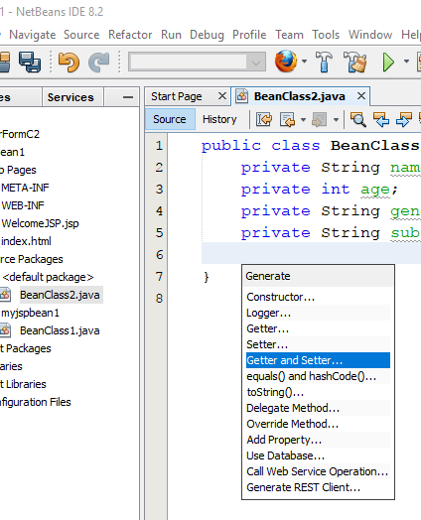
Bean Class Creation
Getter-Setter Window
Click right button of the mouse and find “Insert Code”.
Find “Getter and Setter” method and click it.

Slide 34
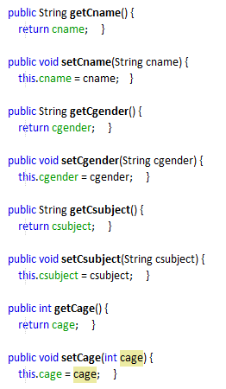
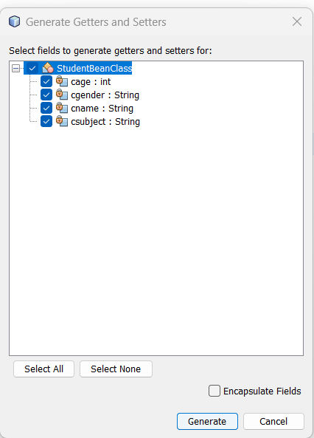
Bean Class Creation
Generated Code
Select all and click “Generate”

Slide 35
JSP Directives
The JSP directives are messages that tells the web container how to translate a JSP page into the corresponding servlet.
Page => <%@ page … %>
Include => <%@ include …%>
Taglib => <%@ taglib ….%>
Syntax of JSP Directive
<%@ directive attribute="value" %>

Slide 36
JSP Directives - page
The page directive defines attributes that apply to an entire JSP page. The syntax is:
<%@ page attribute="value" %>
The attributes are – import, contentType, extends, info, buffer, language, isELignored, isThreadSafe, autoFlush, session, pageEncoding, errorPage, isErrorPage
E.g.
<%@ page import="java.util.Date" %>
<%@ page contentType=application/msword %>
Today is: <%= new Date() %>

Slide 37
JSP Directives - include
The include directive is used to include the contents of any resource it may be JSP file, HTML file or text file. The include directive includes the original content of the included resource at page translation time (the JSP page is translated only once so it will be better to include static resource). The advantage is code reusability. The syntax is:
<%@ include file="resourceName" %>
Example: it includes the content of the header.html file. To run this example you must create an header.html file.
<html>
<body>
<%@ include file="header.html" %>
Today is: <%= java.util.Calendar.getInstance().getTime() %>
</body>
</html>

